Slide 1

LEPTOSPIROSIS AND MELIOIDOSIS
EMERGENCY DEPARTMENT CME
09.08.2018
Dr Wan Amni Zulkifar
Supervisor: Dr Fatin Salwani

Slide 2

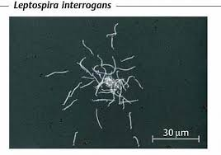
LEPTOSPIROSIS Weil's disease, Weil-Vasiliev disease, Swineherd's disease, rice-field fever, waterborne fever, nanukayami fever, cane-cutter fever, swamp fever, mud fever, Stuttgart disease, and Canicola fever¹

Slide 3
EPIDEMIOLOGY
Zoonosis found worldwide
Annual incidence ranging from 0.1 to 1 per 100 000 per year in temperate climates; 10 or more per 100 000 per year in the humid tropics ²
Pathogenic leptospires belong to the species Leptospira interrogans (subdivided into more than 200 serovars with 25 serogroups)
Leptospires survive best in fresh water, damp alkaline soil, vegetation and mud with temperatures higher than 22°C
Starts at the onset of the rainy season and declines as the rainfall recedes

Slide 4
ANIMAL INFECTION ¹ | Infects wild and domestic animals (rodents most important reservoirs for maintaining transmission) Infection in rodents usually occurs during infancy  persist for long periods in the renal tubules of animals with little or no evidence of disease or pathological changes in the kidney  shed organism intermittently throughout life
HUMAN INFECTION ¹ | Exposure to environmental sources (animal urine, contaminated water or soil, or infected animal tissue) Common portals of entry: cuts or abraded skin, mucous membranes or conjunctivae Risk factors: occupational exposure (farmers, sewer workers), water recreational activities, household exposure (rodent infestation, poor housing sanitation, flood-prone slums ³)

Slide 5
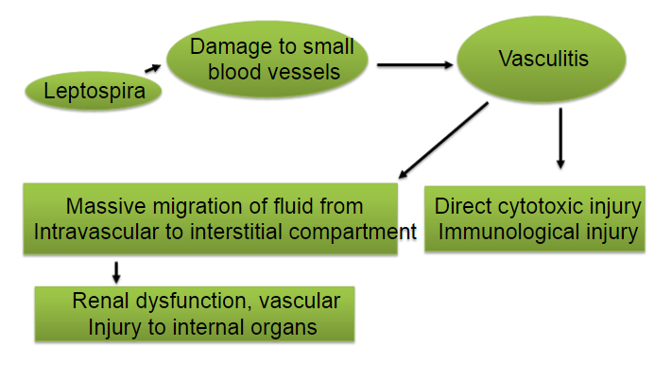
PATHOPHYSIOLOGY

Slide 6
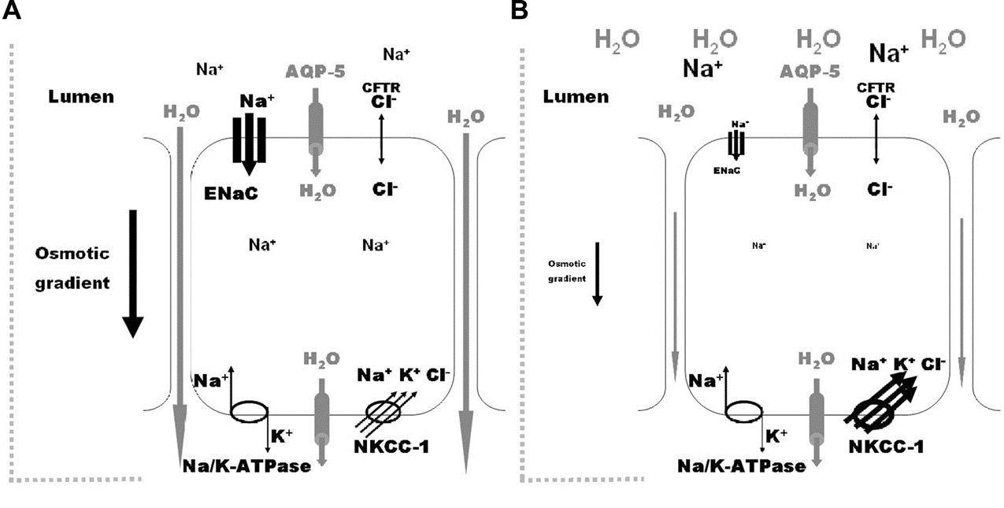
Figure 6 Andrade L, Rodriques AC, Sanches TRC, Souza RB, Seguro AC. Leptospirosis Leads To Dysregulation Of Sodium Transporters In The Kidney And Lung. American Journal Of Physiology. 2007: 292(2)

Slide 7
CLINICAL MANIFESTATION
Incubation period is usually 10 days, with a range of 2 to 30 days ²
Clinical manifestations are highly variable. Typically, the disease presents in four broad clinical categories ²:
Mild, influenza-like illness (ILI)
Weil's syndrome characterized by jaundice, renal failure,haemorrhage and myocarditis with arrhythmias
Meningitis / meningoencephalitis
Pulmonary haemorrhage with respiratory failure

Slide 8
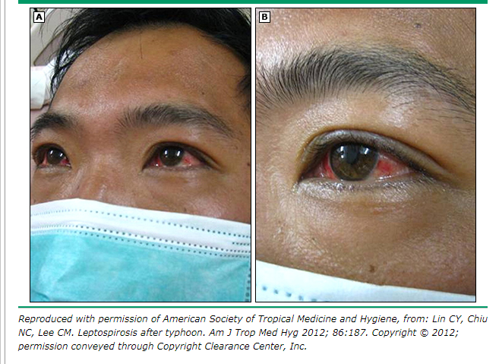
Conjunctival suffusion
Conjunctival redness
☒ Exudate

Slide 9
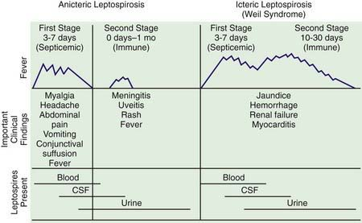
80-90 %
About 10%

Slide 10
Significant predictors of death include pulmonary involvement and CNS disease ⁴
High case fatality rates associated with jaundice (median mortality 19 percent), renal failure (12 percent) and age >60 years (60 percent) ⁵
Risk factors for development of severe leptospirosis include delay >2days of initiation of antibiotics from onset of symptoms and infection due to Leptospira interrogans serogroup Icterohaemorrhagiae ⁶

Slide 11
LABORATORY STUDIES AND IMAGING
PARAMETER | RESULTS
Full blood count | Significant anemia Raised WBC (3000-26000 cells/μL) with left shift Thrombocytopenia
Renal profile | Hyponatremia Hypokalemia Raised urea and creatinine (reduced GFR)
Liver function | Minimal to moderate transaminase elevation Hyperbilirubinemia (1026-1368mmol/L)
Serum creatinine kinase | Markedly raised
Electrocardiogram | Myocarditis, 1st degree heart block
Urinalysis | Proteinuria, pyuria, granular casts and microscopic haematuria

Slide 12
CSF analysis (raised lymphocytes/ neutrophils, elevated protein with normal glucose levels)
Chest radiograph (small nodular densities  consolidation/ ground glass appearance)
Parameter | Results
CSF analysis | Raised neutrophils Elevated proteins Normal glucose levels
Chest radiograph | Small nodular densities Consolidation Ground glass appearance
Oliguria + WBC > 12900 + ECG repolarisation abnormalities + alveolar infiltrates on chest radiograph = ADVERSE OUTCOME

Slide 13
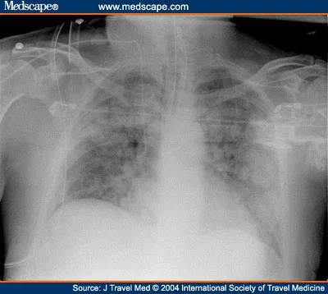

Slide 14
DIAGNOSTIC TOOLS
SEROLOGY | Leptospirosis rapid test (ELISA) | Detect mainly IgM antibodies (positive after 5 to 10 days after onset of symptoms) *Can remain detectable for several years *If taken at early stage, need follow-up sample
 | Leptospirosis MAT | GOLD standard *Marker for treatment response
CULTURE | Isolation of organism | Blood first 7 days CSF days 4 – 10 Urine ≥ day 7
TISSUE ANALYSIS | PCR or immunohistochemical staining *Post-mortem diagnosis

Slide 15
CLINICAL CASE | PROBABLE CASE | CONFIRMED CASE
+ History of exposure to water and/ or environment possibly contaminated with animal urine | CLINICAL CASE and positive rapid test | PROBABLE CASE with any of the following laboratory results MAT (single serum specimen ≥ 1:400 or paired sera of four fold or greater titre) Positive PCR Positive culture for pathogenic leptospires Leptospires in tissues using immunohistochemical staining
+ ANY OF THE SYMPTOMS Headache Myalgia (calf and lumbar region) Arthralgia Conjunctival suffusion Meningism Anuria or oliguria Jaundice Haemorrhage Cardiac arrythmia or failure Skin rash GIT symtoms

Slide 16
TREATMENT
ADULTS | Mild: PO doxycycline (2mg/kg up to 100mg 12-hourly for 5-7 days), tetracycline, ampicillin or amoxicillin
 | Severe: IV C-penicillin (2 MU 6-hourly for 5-7 days) *Third generation cephalosporins e.g. ceftriaxone and cefotaxime also effective
PAEDIATRICS | Mild > 8years: PO doxycycline (4mg/kg 12-hourly for 7 days) Mild < 8years: PO ampicillin 75-100mg/kg 6-hourly for 7 days) OR PO amoxicillin (50ng/kg 6-8hourly for 7 days)
 | Severe: IV penicillin G (100000 U/kg 6-hourly for 7 days)

Slide 17
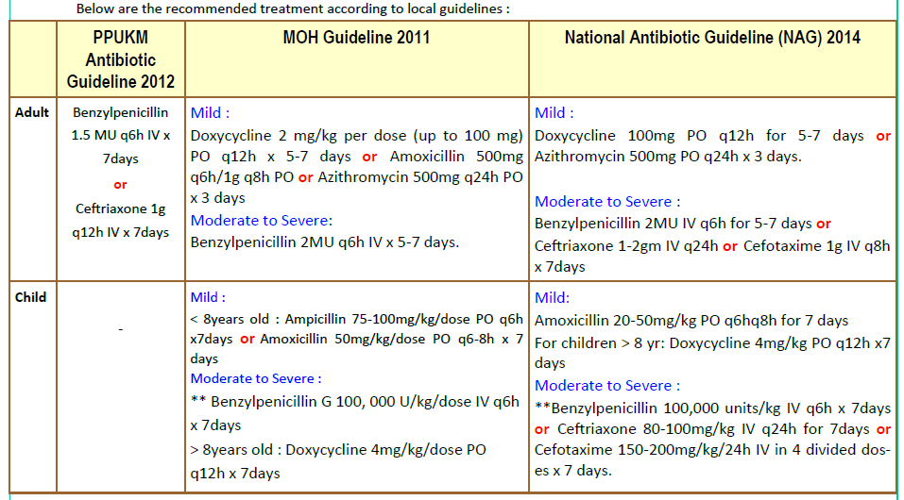
Pharmacy Department, HCTM, PPUKM. Updates On Leptospirosis In Malaysia. Edition 17, Issue 11.

Slide 18
PROPHYLAXIS
Cost effectiveness and risk versus benefits unclear
Pre-exposure: PO doxycycline 200mg stat then weekly throughout stay OR PO azithromycin 500mg stat then weekly throughout stay (pregnant, allergy to doxycycline)
Post-exposure: PO doxycycline 200mg stat then 100mg BD for 5-7 days if symptomatic with first onset of fever OR PO azithromycin 1g on Day-1 then 500mg daily for 2 days

Slide 19

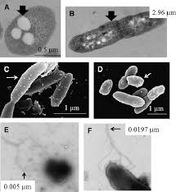
MELIOIDOSIS

Slide 20
EPIDEMIOLOGY
Caused by facultative intracellular gram negative bacterium, Bukholderia pseudomallei
Widely distributed environmental saprophyte in soil and fresh surface water in endemic regions
Endemic in South East Asia and North Australia. Majority of diagnosed cases are from Thailand, Malaysia, Singapore and northern Australia ⁷
In Sabah, about 70 cases reported in 2013 with incidence rate of 0.16 per 100, 000 populations per year (Kota Kinabalu reported the highest followed by Penampang and Tuaran) ⁸
Commonly occurs between ages 40-60 years

Slide 21
TRANSMISSION
Acquired from:
i. Inhalation of contaminated dust particles
ii. Direct contact with contaminated soil and water through penetrating wounds, existing skin abrasions, burns
iii. Aspiration of contaminated water
iv. Ingestion of contaminated water
B. pseudomallei behaves as an opportunistic pathogen
Risk factors: Diabetes (57-74% of cases), hazardous alcohol use/ chronic liver disease, chronic renal disease, chronic lung disease, SLE, HIV, malignancy and thalassemia major amongst paediatrics

Slide 22
INCUBATION PERIOD | Ranges from 1-21 days (mean 9 days) *Influenced by inoculation dose, mode of transmission, host risk factors
ACUTE VS CHRONIC INFECTION | Acute (symptoms lasting < 2 months before establish diagnosis) VS chronic (symptoms persisting > 2months) Chronic melioidosis present with pneumonia mimicking tuberculosis or non-healing skin ulcer/ abscess
LATENT INFECTION WITH REACTIVATION | Reported latent periods between exposure in endemic regions to development in non-endemic regions as long as 26 to 62 years in the United States and 19 to 24 years in Australia

Slide 23
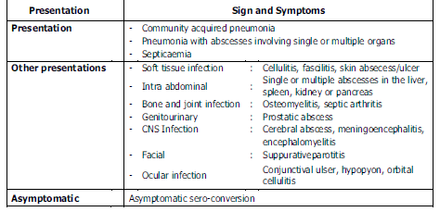
CLINICAL MANIFESTATION

Slide 24
Suspect IF
Patient is residing and/ or working in endemic area
Patient with diabetes mellitus
Patient with high grade fever acute or prolonged
History of exposure to contaminated environment (dust, soil or water)
Progressive pneumonia (CXRay deteriorating with few hours or 2-3 days) not responding to commonly used antibiotics
Presence of hepatomegaly and/ or splenomegaly

Slide 25
LABORATORY AND IMAGING
CULTURES | Mainstay of diagnosis 2 sets of blood cultures before initiation of antibiotics All suspected patient should have blood, sputum, urine, swab of ulcer, abscess fluid, throat swab and rectal swab
SEROLOGY | Indirect hemagglutination test (IHAT) is available but not a reliable method of diagnosis
MOLECULAR DIAGNOSIS (PCR) | Blood, urine and other involved body secretion
CHEST RADIOGRAPH | Acute pneumonia (discrete, diffuse or patchy lobar consolidation, necrotising lesions and pleural effusion) Chronic include cavitating, nodular or streaky infiltrates with fibrotic changes
COMPUTED TOMOGRAPHY AND MAGNETIC RESONANCE IMAGING | CT of abdomen and pelvis should be done routinely for all suspected melioidosis patients

Slide 26
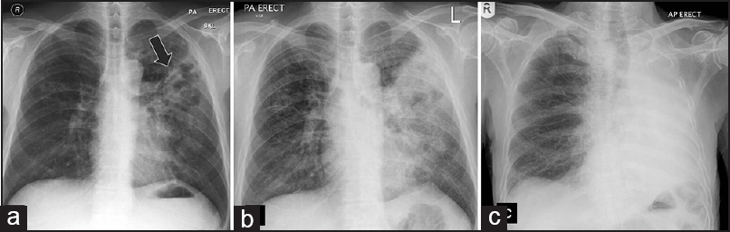
Alsaif HS, Venkatesh SK. Melioidosis: Spectrum of Radiological Manifestations. Saudi Journal of Medicine and Medical Sciences. 2016:4(2)

Slide 27
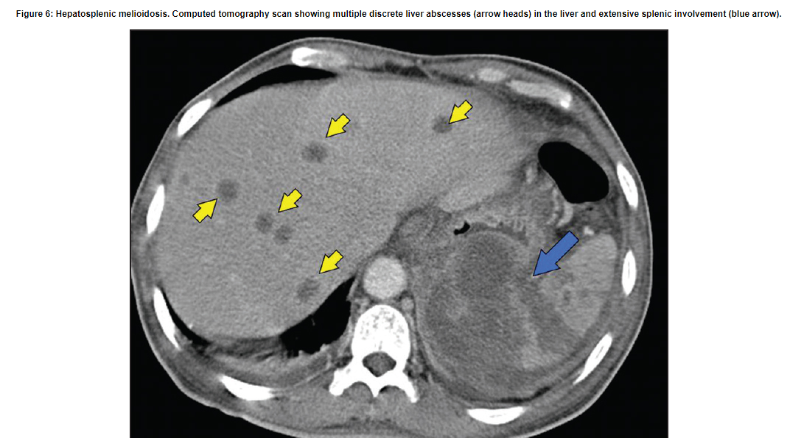

Slide 28
TREATMENT
ADULTS | INTENSIVE THERAPY | Life-threatening e.g. intubated patients | IV meropenem (25mg/kg or 1g TDS for at least 2 weeks)
 |  |  | + May add PO co-trimoxazole (trimethoprim-sulphamethoxazole) 3-4 tab BD and PO folate 5mg daily
 |  |  | Consider G-CSF within 72 hours of admission
 |  | Other melioidosis | IV ceftazidime (100mg/kg a day or 2g TDS)
 |  | Localized superficial melioidosis | PO augmentin (amoxicillin/clavunate) 625mg TDS for 12-20 weeks
 | ERADICATION THERAPY |  | PO co-trimoxazole 2-4 tab BD and PO doxycycline 100mg BD for total of 20 weeks OR PO augmentin 625mg TDS

Slide 29
PAEDIATRICS | INTENSIVE THERAPY | IV ceftazidime (50mg/kg 6-8 hourly for at least 2 weeks, 4-8 weeks for deep seated infection)
 | ERADICATION THERAPY | PO amoxicillin (20mg/kg)/clavunate 8-hourly for total of 20 weeks OR PO co-trimoxazole (trimethoprim 8mg/kg and sulphamethoxazole 40mg/kg) and PO doxycycline (4mg/kg in 2 divided doses)

Slide 30
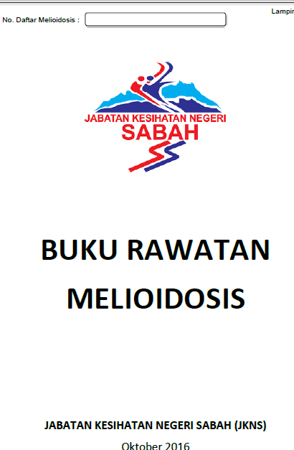
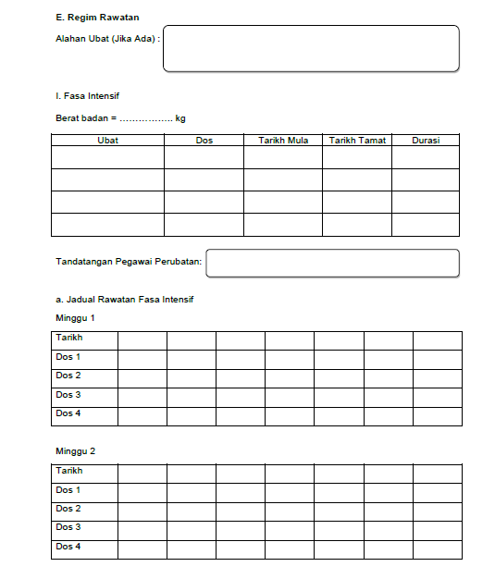


Slide 31
REFERENCES
Day, DM. Leptospirosis: Epidemiology, microbiology, clinical manifestations, and diagnosis. In: UpToDate, Calderwood, SB, 2018.
Disease Control Division Department of Public Health Ministry of Health Malaysia, Guidelines for the Diagnosis, Management, Prevention and Control of Leptospirosis in Malaysia, 2011. Available from : http://www.moh.gov.my/images/gallery/Garispanduan/GL_Leptospirosis%202011.pdf
Jesus MS, Silva LA, Lima KM, Fernandes OC. Cases distribution of leptospirosis in City of Manaus, State of Amazonas, Brazil, 2000-2010. Rev Soc Bras Med Trop. 2012 Dec;45(6):713-6.
Pappachan MJ, Mathew S, Aravindan KP, Khader A, Bharghavan PV, Kareem MM, Tuteja U, Shukla J, Batra HV. Risk factors for mortality in patients with leptospirosis during an epidemic in northern Kerala. Natl Med J India. 2004;17(5):240.
Taylor AJ, Paris DH, Newton PN. A Systematic Review of the Mortality from Untreated Leptospirosis. PLoS Negl Trop Dis. 2015;9(6):e0003866. Epub 2015 Jun 25.
Tubiana S, Mikulski M, Becam J, Lacassin F, Lefèvre P, Gourinat AC, Goarant C, D'Ortenzio E. Risk factors and predictors of severe leptospirosis in New Caledonia. PLoS Negl Trop Dis. 2013;7(1):e1991. Epub 2013 Jan 10.
Currie, MBBS, Anstey, MBBS. Epidemiology, clinical manifestations, and diagnosis of melioidosis. In: UpToDate, Sexton, DJ, 2016.
Sabah Health Department, Guideline for Clinical and Public Health Management of Melioidosis in Sabah, 2014. Available from : http://www.jknsabah.gov.my/v2/muatturun/kesihatanawam/GarisPanduanPenyakitBerjangkit/Guideline%20For%20Clinixcal%20and%20Public%20Health%20Management%20Of%20Melioidosis%20In%20Sabah.pdf
Jabatan Kesihatan Negeri Pahang, Guidelines for Clinical and Public Health Management of Melioidosis in Pahang. Available from : http://www.moh.gov.my/images/gallery/Garispanduan/Guidelines%20of%20Clinical%20&%20Public%20Health%20Management%20of%20Melioidosis%20In%20Pahang.pdf

